Slide 1
List of clients and their Testimonials
Vinay Sagare
Akash Goyal
Yash Pawar
Dipak Chauhan
Shriraj Jadhav
rashant Shirke
Prajakta Shinde
Abhishek Ankush
Ravi Chauhan
Aparna Shukla
Suman Goswami
Koyal Sawant
Chetan Bangera
Sandeep Suthar
Shreeraj Nikam
Upendra Dandawate

Slide 2
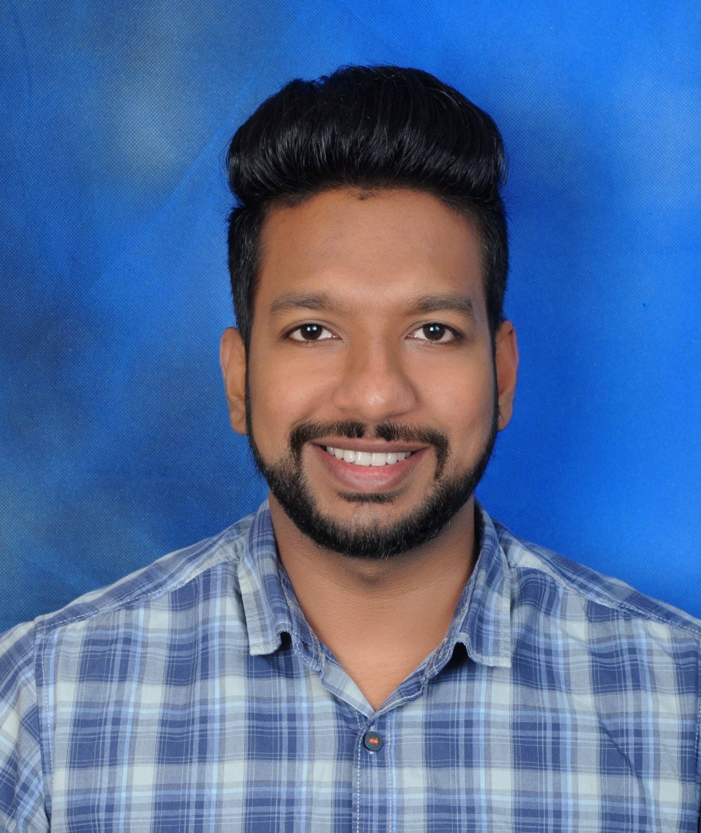
Name : Vinay Sagare
Designation: Senior Software Engineer
Caption:
“Finally trading profitably after years of struggle with Travesting Money’s Mentorship & Swing Subscription Plan ”
Review:
"I had been trading for years without seeing consistent profits — hopping between tips and strategies. Joining Travesting Money’s June batch of the Market Mastery Program was the turning point. Their structured mentorship, practical learning, and real-time examples helped me finally understand profitable trading. I also subscribed to their Swing Trading Plan — the entry, exit, stop loss, and risk-reward guidance is precise, and most targets hit if followed properly. Now, I’m finally profitable and trading with clarity and conviction. A complete package for anyone serious about trading success."

Slide 3
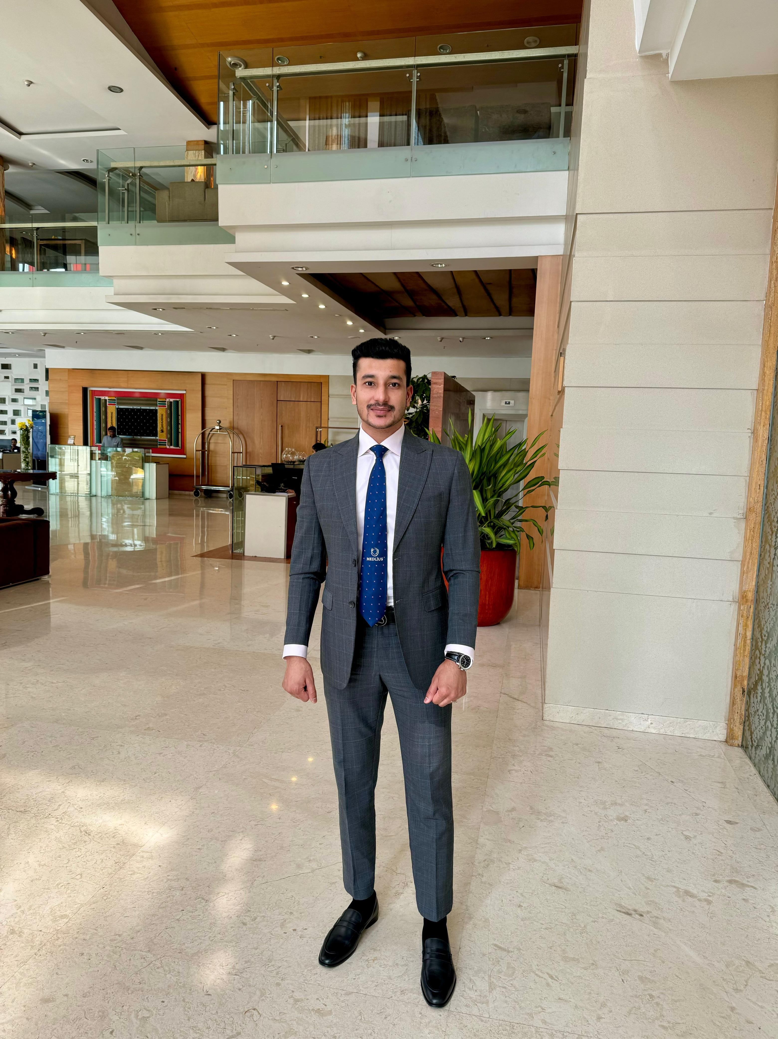
Name: Akash Goyal
Designation: Founder & CEO -Medlius Pharma Pvt Ltd
Caption:
Rare to find this level of research outside big institutions. Travesting Money stands out for all the right reasons.
Review:
"Being from a completely different industry, I always wanted a research-oriented and ethical stock market advisory — and Travesting Money exceeded my expectations. The quality of research reports, diversification approach, and clarity on entry-exit points show the professionalism they carry. It’s rare to see such data-driven research outside institutional setups."

Slide 4
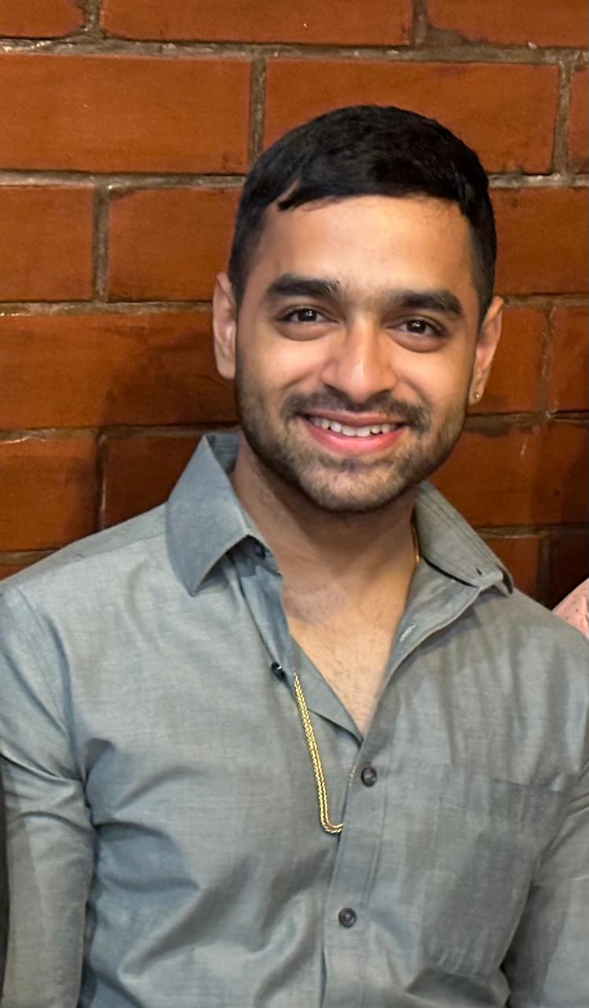
Name: Yash Pawar
Designation: Real Estate Developer
Caption:
Well-structured Entries, Exits, SL and consistent profits with discipline
Review:
"I subscribed to the short to mid-term swing trading plan, and I must say — their entry, exit, and stop loss levels are extremely well-structured. With discipline and following their guidance, I started seeing profits consistently. The setup is professional and designed for serious traders."

Slide 5
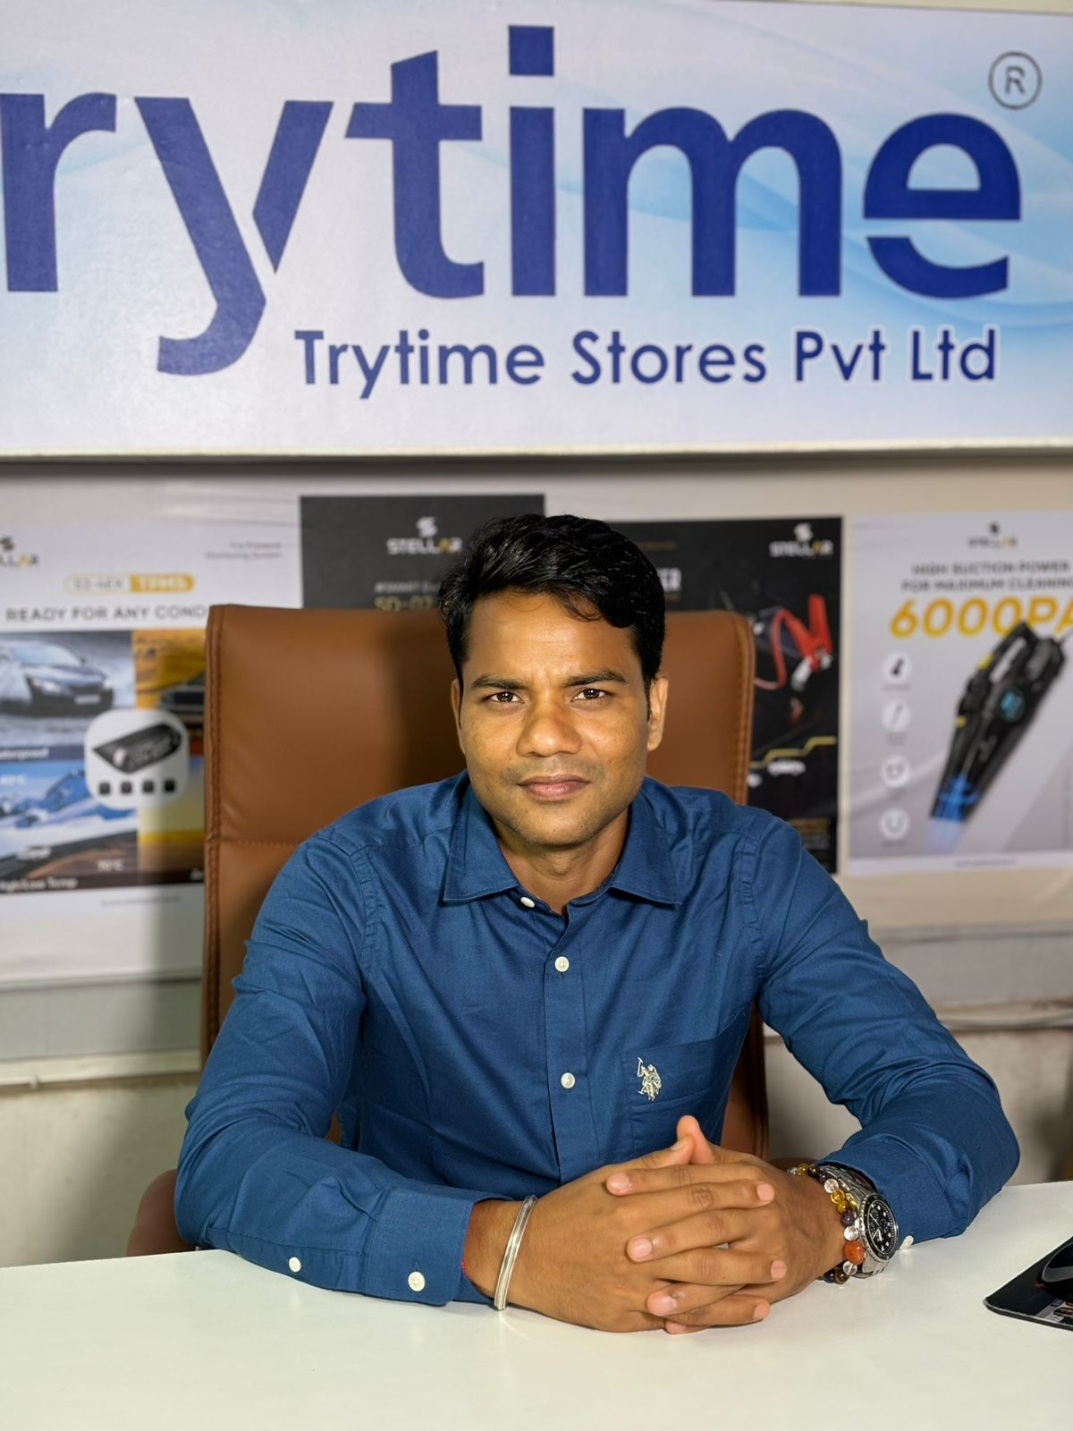
Name: Dipak Chuhan
Designation : Director at Trytime Stores Pvt. Ltd.
Caption:
From zero to confident trader and investor, all credit to Omkar Sir's unmatched knowledge and mentorship.
Review:
"Joining the mentorship by Omkar Sir helped me truly understand the mechanics behind stock selection. The in-house frameworks, sector rotation strategies, and economic analysis concepts they teach are rarely found in public platforms. It's a serious edge for anyone who wants to take investing seriously."

Slide 6
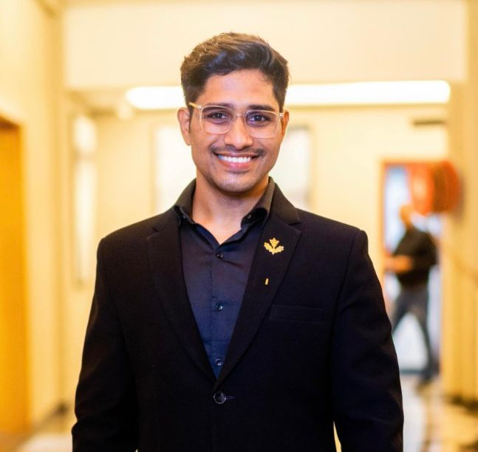
Name: Shriraj Jadhav
Designation: Senior cloud data engineer
Caption:
Choosing a SEBI-registered platform gave me the trust I needed to invest confidently."
Review:
"In a market full of noise, finding a SEBI-registered research analyst like Travesting Money was a game-changer. The transparency, compliance, and ethical practices give me immense confidence that I’m taking advice from a credible source. It’s rare to find such professionalism and trust in stock market advisory services."

Slide 7
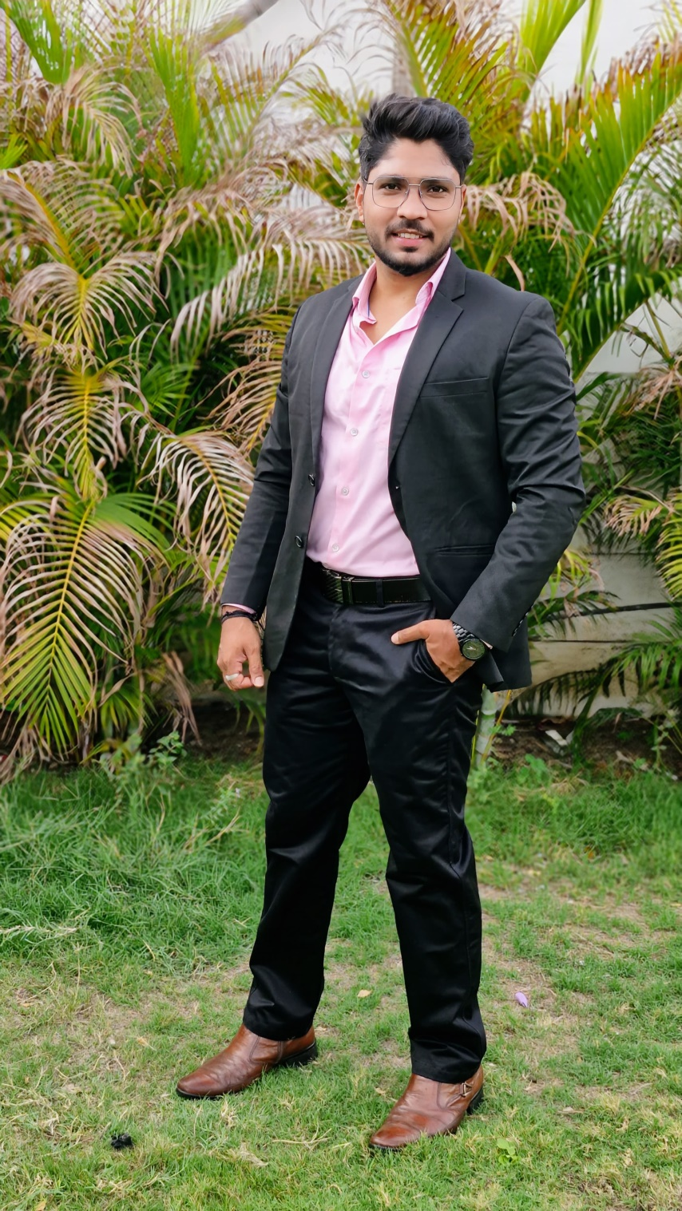
Name: Prashant Shirke
Designation : Senior Product Engineer
Caption:
Profitable options trading doesn’t need to be complicated. Just needs the right mentor.
Review:
Profitable Options Trading Mentorship was a game-changer. I learned how to build directional and non-directional strategies with proper risk management. I now trade options profitably with a structured plan.”

Slide 8
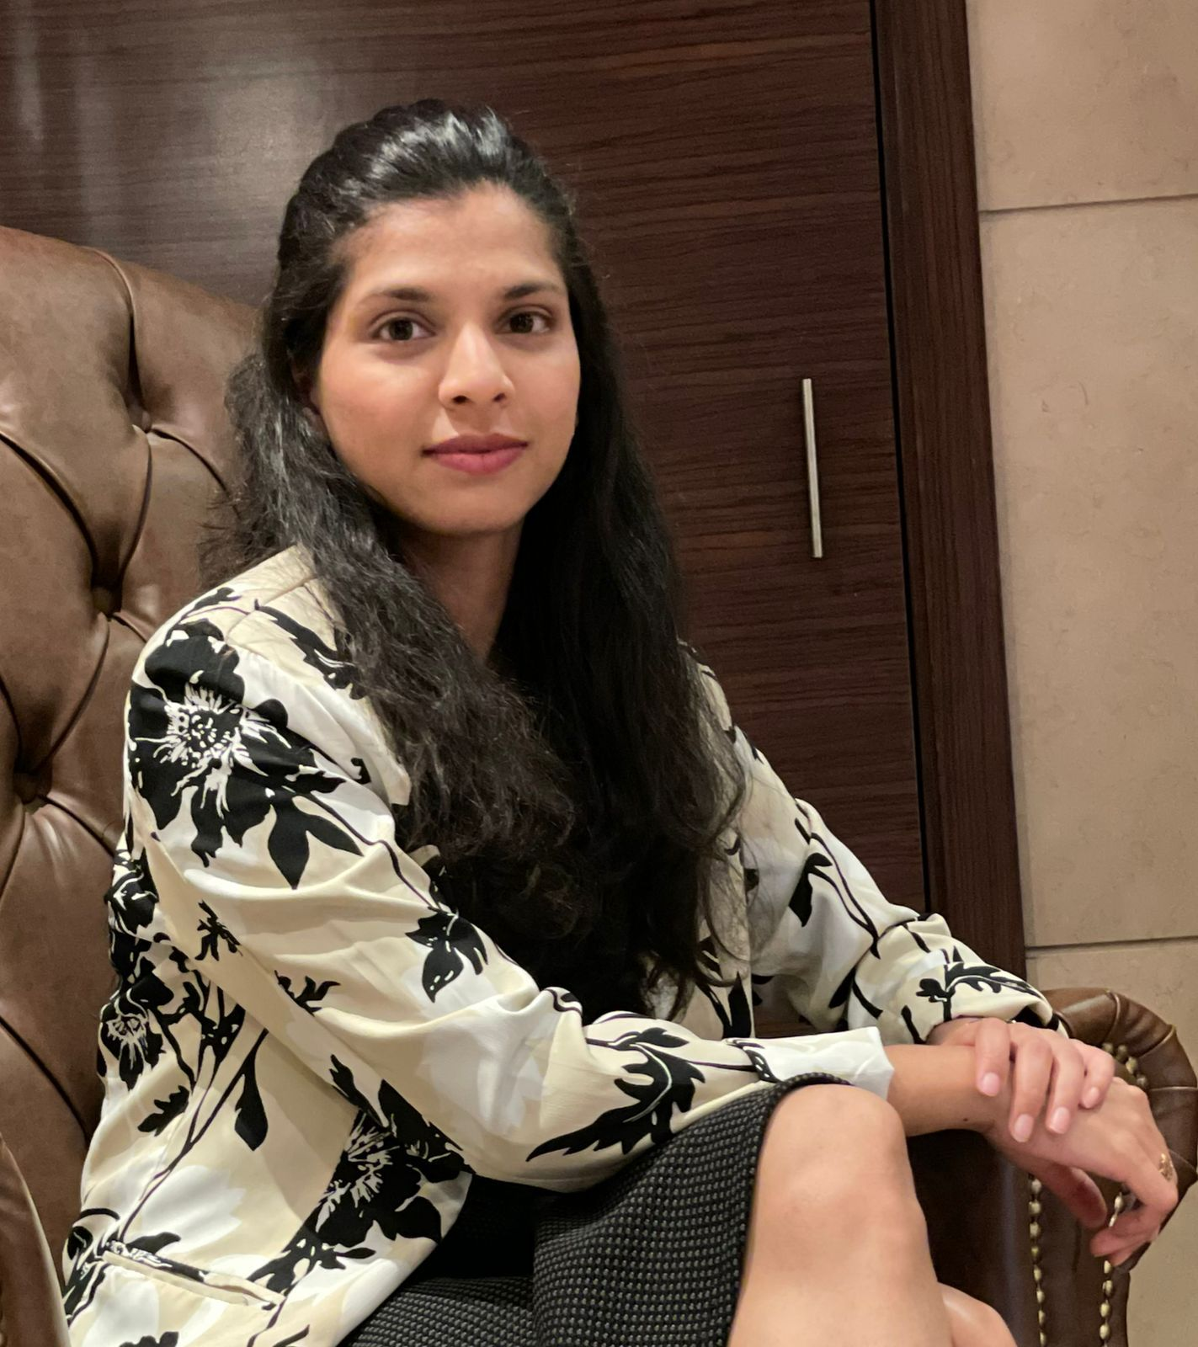
Name: Prajakta Shinde
Designation: Founder and Principal Architect PS Design Studios
Caption:
"I used to believe stock market is not for women — I was so wrong!"
Review:
“What I admire most is the data-driven approach. Each suggestion is backed by clear fundamentals, sector analysis, and future growth potential. As a woman investor, I now feel far more empowered with my investments.”

Slide 9
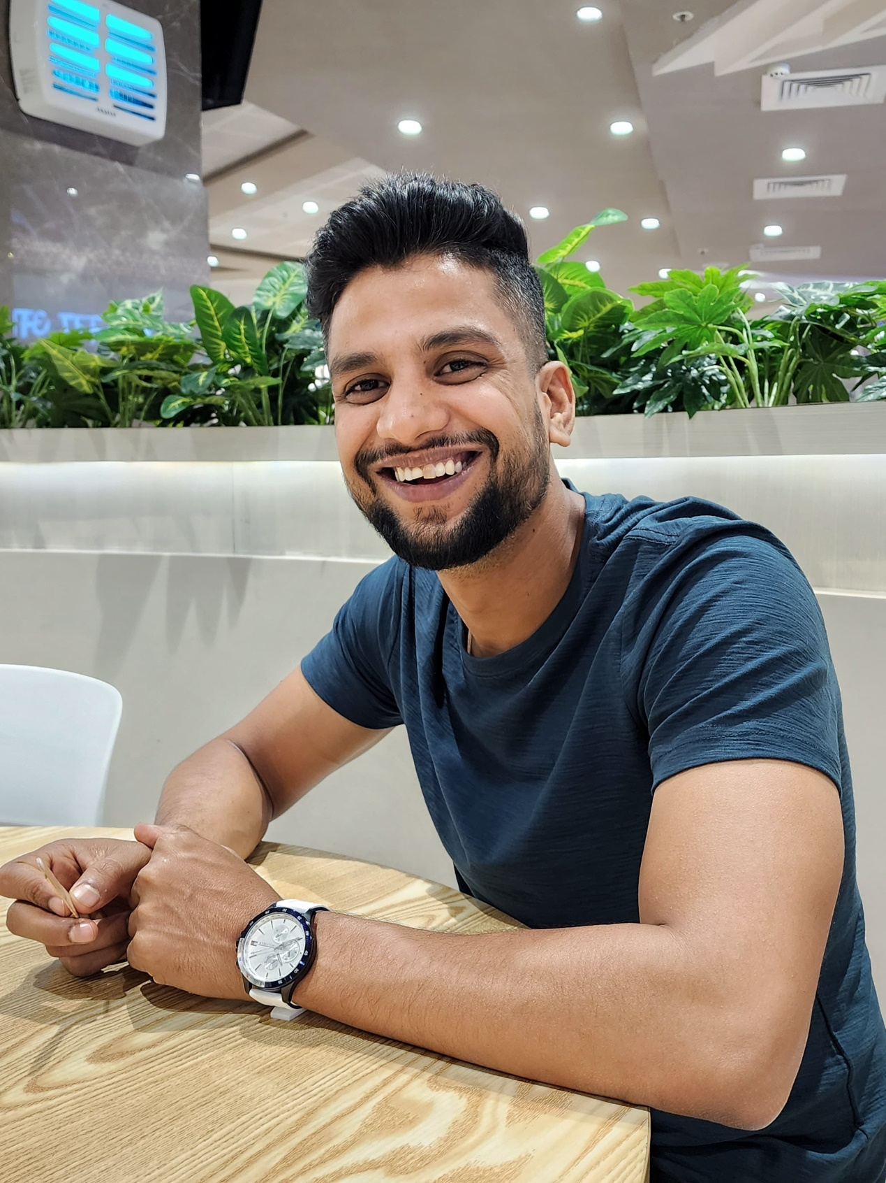
Name: Abhishek Ankush
Designation: Senior Solutions Architect
Caption:
"Respect to Omkar Sir, his experience, depth, and teaching style make complex trading feel so simple."
Review:
“I’ve taken multiple courses online, but nothing compares to the in-depth knowledge and personal guidance offered in the Market Mastery Mentorship. It’s not just education—it's transformation.”

Slide 10
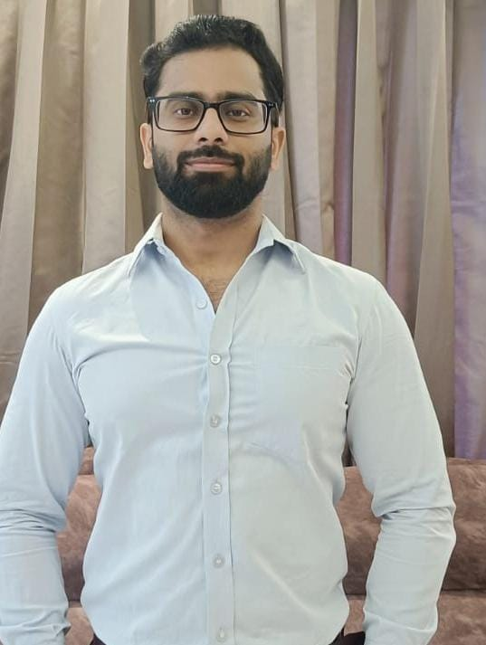
Name: Ravi Chauhan
Designation: Test Automation Lead in Barclays
Caption:
Best platform for working professionals
Review:
"As a working professional, I was looking for short to mid-term trading opportunities that didn’t require constant monitoring. Travesting Money provides exactly that through clearly defined entry and exit points, well-researched targets, and disciplined risk management."

Slide 11
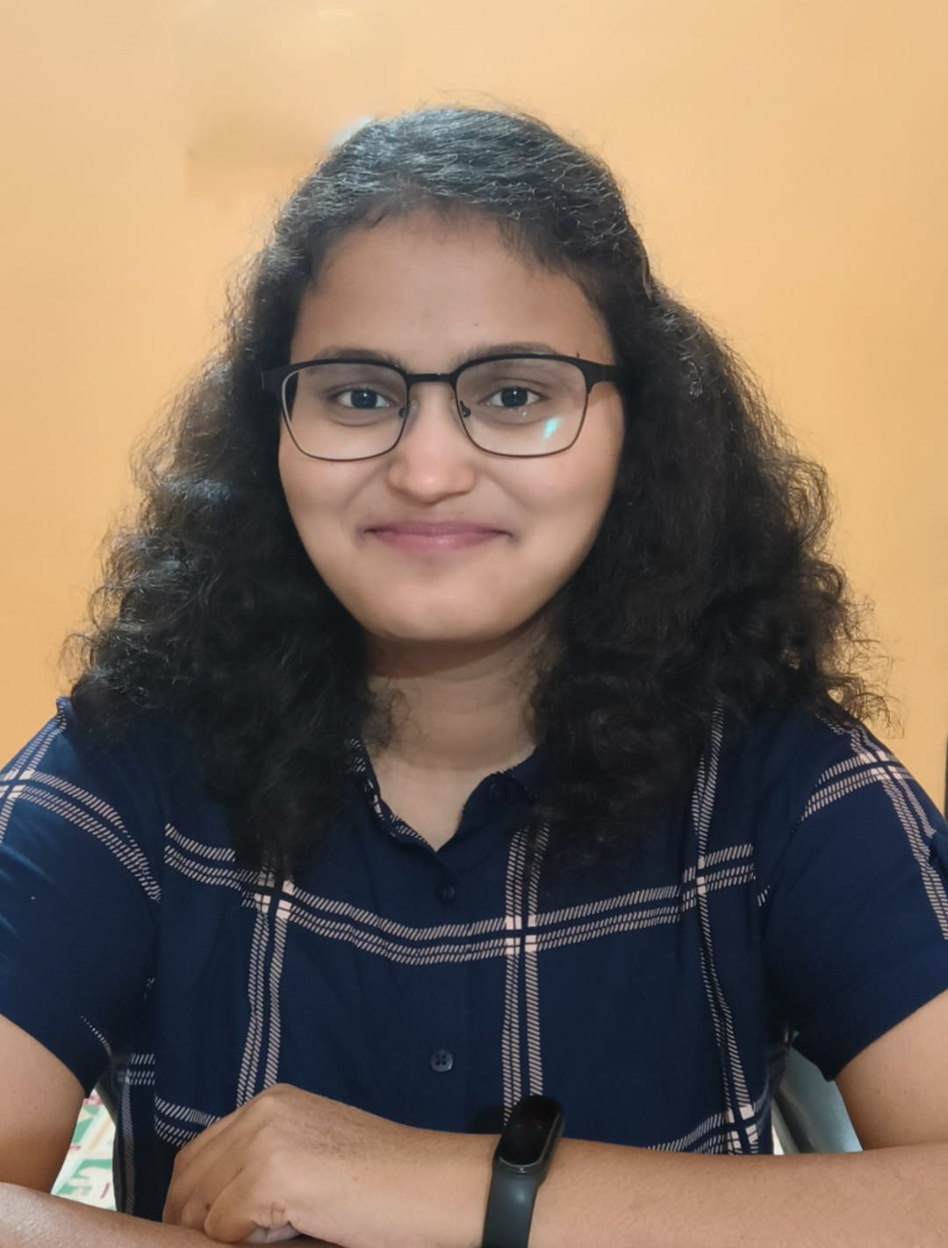
Name: Aparna Shukla
Designation: Back End Engineer II
Caption:
Omkar Sir has literally decoded the markets. No fluff, just pure structured brilliance.
Review:
I joined Travesting Money’s mentorship thinking the market was too complicated for someone like me. But Omkar Sir’s structured teaching, real examples, and in-house frameworks made everything clear. From technical analysis to options trading—I now trade confidently on my own. Truly empowering!"

Slide 12
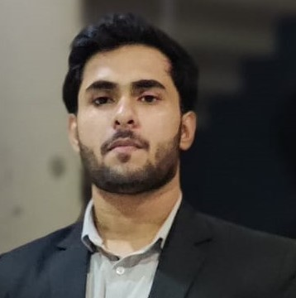
Name: Suman Goswami
Designation: Senior System Engineer
Caption:
Omkar Sir’s deep knowledge and structured systems like PUCORE and Confluence strategies changed how I trade forever.
Review:
Travesting Money’s Technical Analysis Mentorship has completely elevated my trading mindset. What sets it apart is their structured curriculum backed by in-house developed systems like the PUCORE strategy and Confluence trading setup. I gained deep insights into Advanced Technical Analysis, refined Price Action techniques, and even learned the Smart Money Concept (SMC) used by institutions. The mentorship has truly sharpened my understanding of market behavior and helped me build strategies with conviction. It’s not just about patterns—it’s about logic, discipline, and institutional-level thinking.

Slide 13

Name: Koyal Sawant
Designation: Software Developer
Caption:
As a working woman, I now trade and invest confidently — knowledge is power, and this platform gave me both.
Review:
I’ve tried multiple advisory platforms, but Travesting Money stands out for its personalized attention and evidence-backed stock ideas. Their focus on investor education is a big plus for women like me who want to learn while investing.”

Slide 14
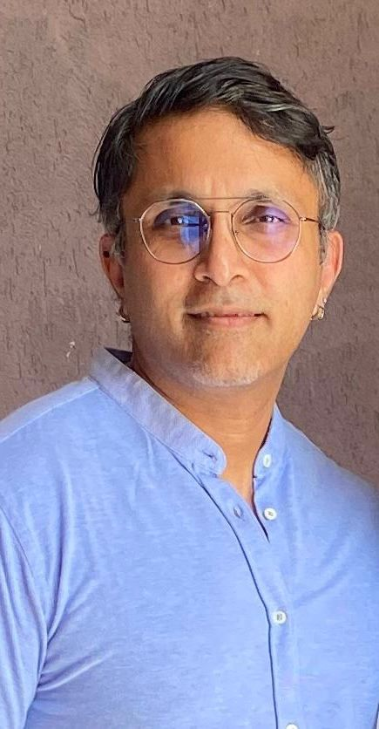
Name: Chetan Bangera
Designation: BI Specialist I Project Manager
Caption:
More value in 3 months than years of random learning.
Review:
“The platform’s combination of SEBI-compliant advisory, expert mentorship, and investor education is unmatched. I’ve learned more in 3 months than in the last 3 years on my own.”

Slide 15
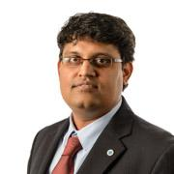
Name: Sandeep Suthar
Designation: Delivery Head
Caption:
Lost money listening to noise. Now I listen to research.
Review:
“I used to trade and invest on the basis of random Telegram tips and YouTube channels, which only led to losses and confusion. After searching for SEBI-registered platforms, I got to know about Travesting Money and subscribed to their swing trading and model portfolio services. It offered research-backed stock ideas with a clear entry, target, and stop loss. The consistency was unmatched. Later, I joined their mentorship program and that’s where the real transformation happened. I learned frameworks, technical setups, and gained the confidence to make independent trading decisions. For the first time, I feel in control of my money.”

Slide 16
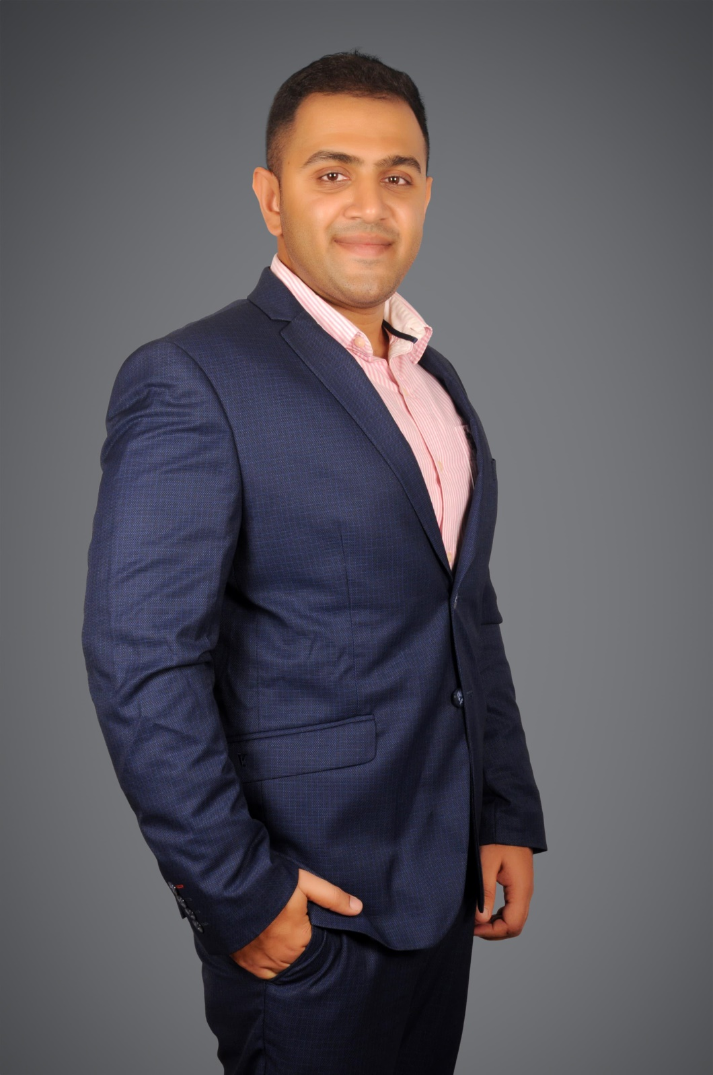
Name: Shreeraj Nikam
Designation: Project Manager
Caption:
"There’s a huge difference between unregulated tips and SEBI-authorized research — I’ve seen both."
Review:
“There’s a huge difference between free advice and real research. Travesting’s short-to-mid term swing trading stock suggestions are curated, logical, and easy to follow even for non-finance professionals like me.”

Slide 17
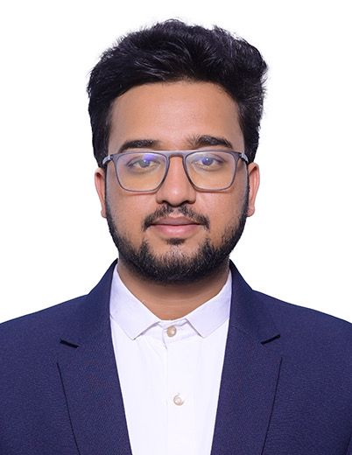
Name: Upendra Dandawate:
Designtion: Product Manager
Caption:
Worth single penny spend. You can understand the research depth in every suggestion.
Review:
What sets them apart is the quality of equity research. Every stock recommendation is backed by detailed analysis, sector outlook, and future growth potential. A truly credible and trustworthy platform.”

